Slide 1

#LifeKoKaroLift
Data Science Certification Program

Slide 2


Course : Data Science
Lecture On : Numpy indexing
Instructor : Shivani Kapania

Slide 3
In Last Class, we covered….
Subset, slice, index and iterate through arrays
Multidimensional arrays

Slide 4
Today’s Agenda
Manipulate arrays
Reshape arrays
Stack arrays
Perform operations on arrays
Perform basic mathematical operations
Apply built-in functions
Apply your own functions
Apply basic linear algebra operations

Slide 5
Reshaping arrays
np.ravel(x)
1
4
3
7
6
2
8
9
1
4
3
7
6
2
8
9
5
1
6
2
5
1
6
2
np.ravel(x)
x
Return a contiguous flattened array.
A 1-D array, containing the elements of the input, is returned.

Slide 6
Reshaping arrays
x.reshape(shape)
Gives a new shape to an array without changing its data.
1
4
1
4
3
7
3
7
6
2
8
9
6
2
5
1
6
2
x.reshape(6,2)
8
9
x
5
1
6
2
1
4
3
7
6
2
8
9
5
1
6
2

Slide 7
Reshaping arrays
x.reshape(shape)
Gives a new shape to an array without changing its data.
1
4
3
7
8
9
1
4
3
7
6
2
6
2
5
1
6
2
8
9
5
1
6
2
x.reshape(6,2)
x
1
4
3
7
6
2
8
9
5
1
6
2

Slide 8
Reshaping arrays
x.reshape(shape)
Gives a new shape to an array without changing its data.
1
4
3
7
1
4
3
6
2
8
9
7
6
2
5
1
6
2
8
9
5
x.reshape(4,3)
1
6
2
x
1
4
3
7
6
2
8
9
5
1
6
2

Slide 9
Reshaping arrays
x.reshape(shape)
Gives a new shape to an array without changing its data.
1
4
3
7
6
2
8
9
1
4
3
7
6
2
8
9
5
1
6
2
5
1
6
2
x.reshape(1,12)
x

Slide 10
Reshaping arrays
x.reshape(shape)
Gives a new shape to an array without changing its data.
1
4
3
7
6
2
8
9
1
4
3
7
6
2
8
9
5
1
6
2
5
1
6
2
x.reshape(12,1)
x

Slide 11
Reshaping arrays
np.hstack((x, y))
Stack arrays in sequence horizontally (column wise).
This is equivalent to concatenation along the second axis (axis = 1)
1
4
3
7
1
4
3
7
6
2
8
9
6
2
8
9
5
1
6
2
np.hstack((x, y))
5
1
6
2
x
y
For horizontal stacking, the number of rows should be the same.

Slide 12
Reshaping arrays
np.vstack((x, y))
Stack arrays in sequence vertically (row wise).
This is equivalent to concatenation along the first axis (axis = 0)
1
4
3
7
1
4
3
7
x
6
2
8
9
np.vstack((x, y))
6
2
8
9
y
For vertical stacking, the number of columns should be the same.

Slide 13
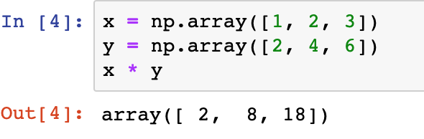
Numpy broadcasting
Numpy operations are usually done element-by-element.
THUS, it requires two arrays to have exactly the same shape.
1
2
3
*
2
8
18
2
4
6
What if arrays have different shapes?

Slide 14
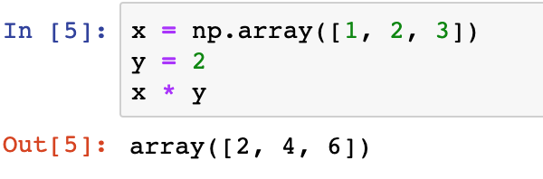
Numpy broadcasting
Broadcasting describes how Numpy treats arrays with different shapes during arithmetic operations.
The smaller array is “broadcast” across the larger array so that they have compatible shapes.
1
2
3
*
2
4
6
2
2
2

Slide 15
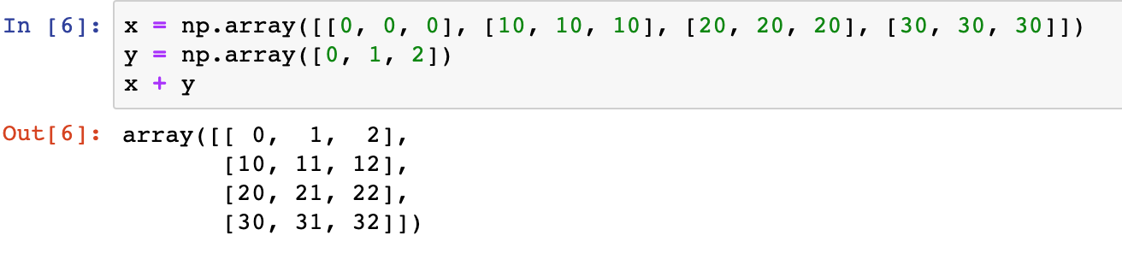
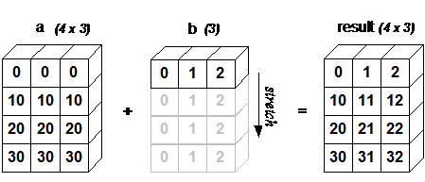
Numpy broadcasting
A 2D array multiplied by a 1D array results in broadcasting if number of 1D array elements matches the number of 2D array columns.

Slide 16
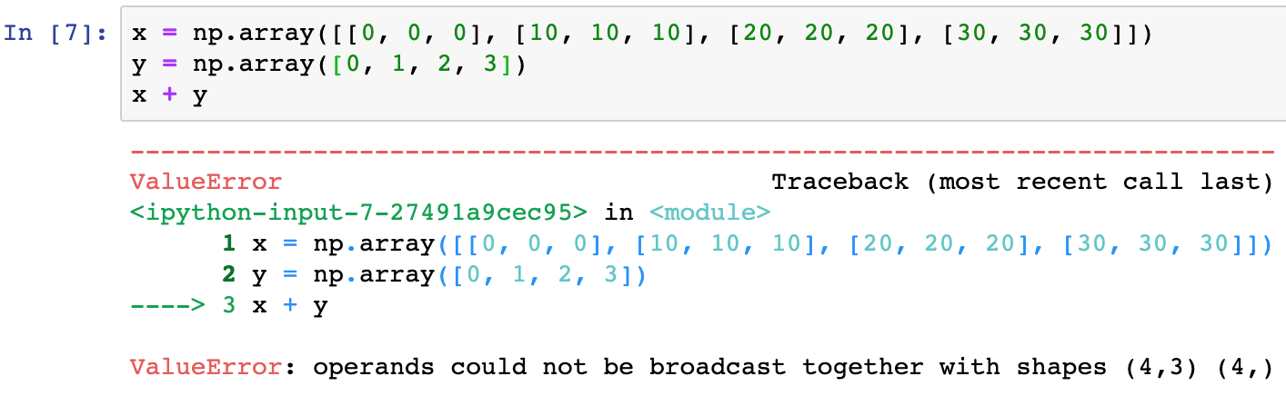
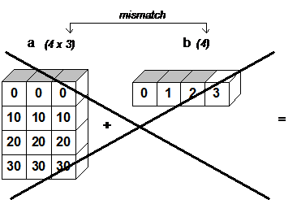
Numpy broadcasting
When the trailing dimensions of the arrays are unequal, broadcasting fails.

Slide 17
Numpy broadcasting
When operating on two arrays, NumPy compares their shapes element-wise. It starts with the trailing dimensions, and works its way forward. Two dimensions are compatible when
they are equal, or
one of them is 1
If these conditions are not met, ValueError exception is thrown.

Slide 18
np.vectorize(pyfunc)
Define a vectorized function
The vectorized function evaluates pyfunc over successive tuples of the input arrays like the python map function, except it uses the broadcasting rules of numpy.
The vectorize function is provided primarily for convenience, not for performance. The implementation is essentially a for loop.

Slide 19
Performing operations on array
Performing mathematical operations on arrays is extremely simple.
Basic Mathematical Operations
NumPy provides almost all the basic math functions - exp, sin, cos, log, sqrt etc. The function is applied to each element of the array.
Linear Algebra Operations
NumPy provides the np.linalg package to apply common linear algebra operations, such as norm, determinant, inverse, eigenvalues and eigen vectors.

Slide 20
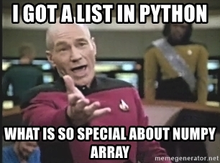
WHY NUMPY?
Numpy
Vectorization
Broadcasting
Indexing

Slide 21
WHY NUMPY?
Vectorization
Practice of replacing explicit loops with array expressions.
Broadcasting
For arrays with different shapes.
Indexing
Basic indexing
Advanced indexing
Express operations as occurring on entire arrays rather than their individual elements.
The smaller array is “broadcast” across the larger array so that they have compatible shapes.

Slide 22
#LifeKoKaroLift
Thank You!

